Slide 1
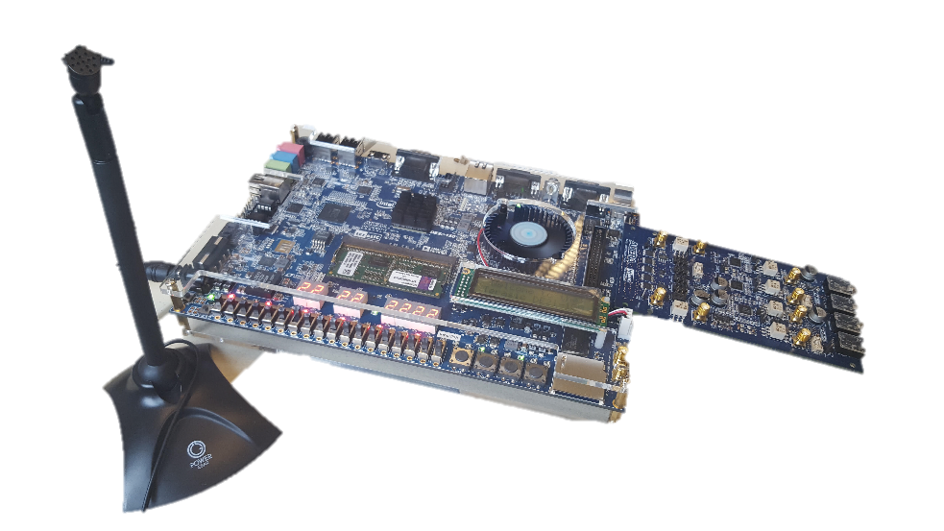
Pitch Shift
Real-time Speech FPGA Implementation
Jake Garrison & Jisoo Jung

Slide 2



Our Project Goal
Realtime pitch shifting optimized for speech
Optional Features
Input melody based pitch shift (autotune)
Harmony capabilities to output multiple pitch shifts to simulate a chorus
Autotune
Chorus

Slide 3

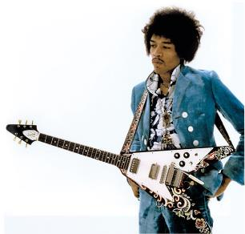
History
Definition: Pitch shifting is a sound recording technique in which the original pitch of a sound is raised or lowered
Before digital sound, this it was extremely difficult to shift the pitch by non interval values
With tape or vinyl you could change pitch by altering the speed of playback
Example: Alvin and the chipmunks
Analog octave pitch shift can be done with rectifier circuit
Example: Jimi Hendrix or Led Zeppelin guitar hardware

Slide 4
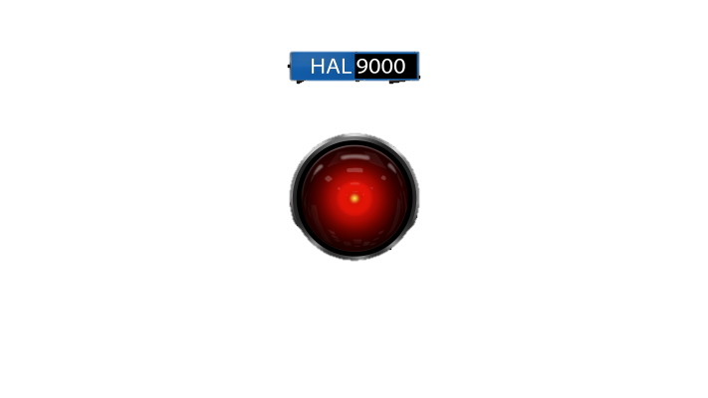

Applications
Voice Privacy
Voice Gender or Age Change
Other Voice Effect
Darth Vader, Alvin and the Chipmonks, SciFi Robot voice
Text to speech / Speech synthesis
Auto Tune / Pitch Correction
Harmony / Chorus
Karaoke
Sampling / Resampling Audio

Slide 5
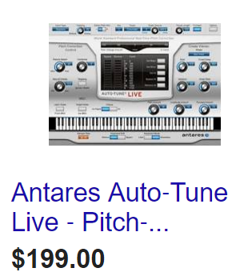

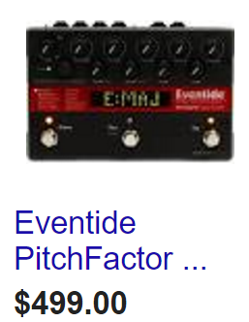
Motivation
Software
Seemed challenging… and is
Fun to play with
Popular in modern music
Most pop music relies on pitch correction
Voice privacy is becoming important
Commercial software implementations are expensive
Hardware implementations is even more expensive
Hardware

Slide 6
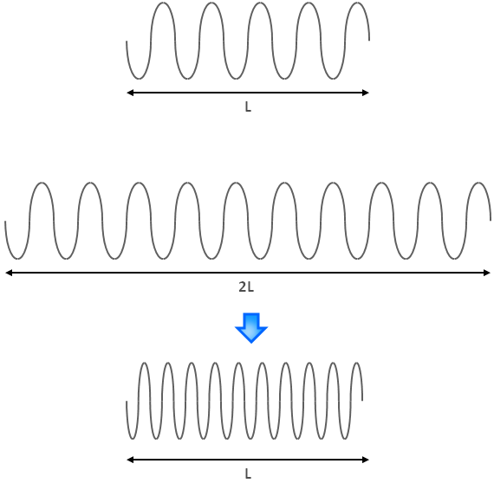
Existing Methods
Analog
Rectifier Circuit (octave only)
Time Domain
PSOLA
Delay Based
Frequency Domain
Phase Vocoder
Physical Modeling
Speech processing, inverse filtering (complex)

Slide 7
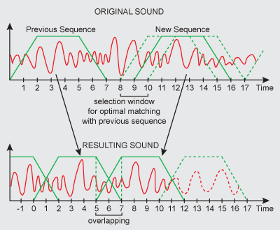
Time Domain Pitch Shift
Pros:
Fast to process
Simple
Ideal for tones
Cons:
Reverberation
Lower Quality
PSOLA (Pitch Synchronous Overlap/Add)
‘P’ will resample the sound, changing the pitch
Uses decimation, then LPF, then interpolation to achieve non-integer resampling
This changes the duration
‘S’ uses correlation so synchronize the ‘OLA’
Uses correlation to find the best way to overlap and add the stretched or compressed sections
‘OLA’ is overlap and add
This is what will stretch or compress the sample to the original length

Slide 8
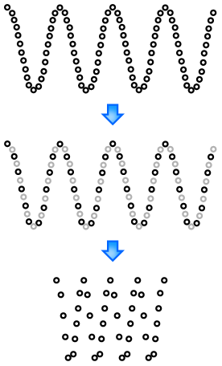
Resampling
Resampling changes pitch
Stretching maintains original sample length
Both are needed!
Integer resampleing is easy
2x upsample, insert 0s every other sample
2x downsample, remove every other sample
Pitch shift requires non-integer resampling (stretch by 1.5, resample by 1/1.5)
Decimation: downsamples and filter
Interpolation: filter then upsample
FIR filter used to obey Nyquist (no aliasing!)

Slide 9
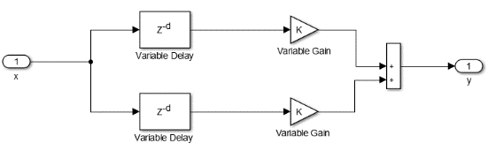
Time Domain Pitch Shift (continued)
Delay Based (Doppler Effect)
Remember the Doppler effect (sirens)
Conceptual: Imaging capturing a moment when the siren pitch is shifted, and repeating it…perpetually
This nifty algorithm does this, and doesn’t require resampling or FFT or filters!
Can actually be done with tape (Wendy Carolos)
Relies on two independent delays crossfading
Best for our FPGA friend
Pros:
Fast to process
No filtering
No resampling
Better than SOLA
Cons:
Unwanted random frequencies
Confusing

Slide 10
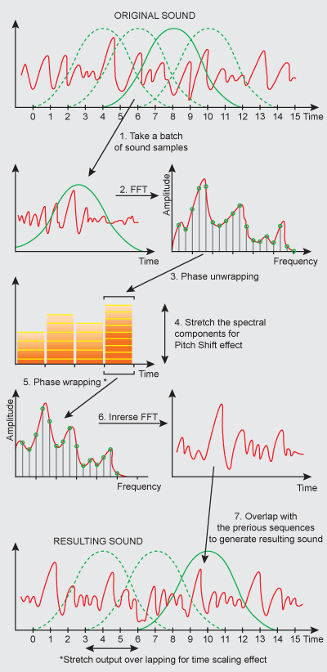
Frequency Domain Pitch Shift
Phase Vocoder
Relies on STFT manipulation
Steps
Analysis (Both Domains)
Windowing (hanning window), then FFT
Overlap windows by X %
Processing (Frequency Domain)
Stretch spectral content (lots of math here!)
Adjust phase to change pitch and transition between bins
Synthesis (Time Domain)
IDFT, then windowing to smooth
Sample is time stretched
Resample to pitch shift
Pros:
Best quality
Customizable
Ideal for speech
Cons:
Several FFT + arctan
Slow
Complex

Slide 11
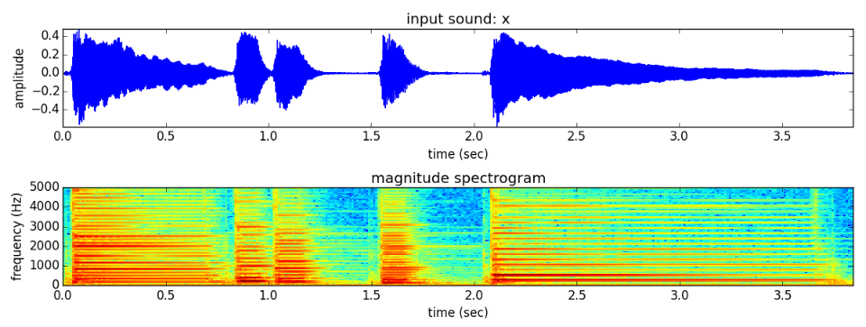
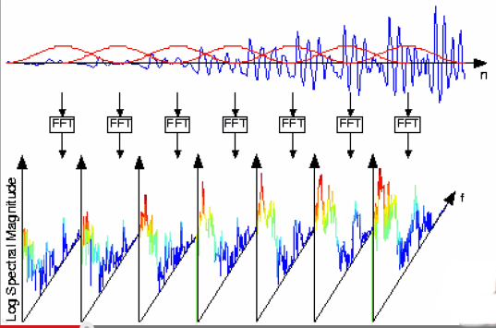
STFT
Piano above. Can see harmonics and decay. Shows, time, frequency and magnitude
Combine several FFTs to create STFT

Slide 12



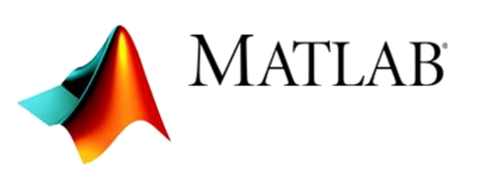





Current State
C Demo (compiles on Atom Processor)
Phase Vocoder (wav file)
Phase Vocoder (real-time)
PSOLA (wav file)
Delay Based (wav file)
Real-time FPGA
Phase Vocoder
PSOLA
Delay Based
Matlab Demo
Phase Vocoder (wav file)
Delay Based (wav file)
Post processing analysis
SUCCESS
FAIL
IN PROGRESS

Slide 13
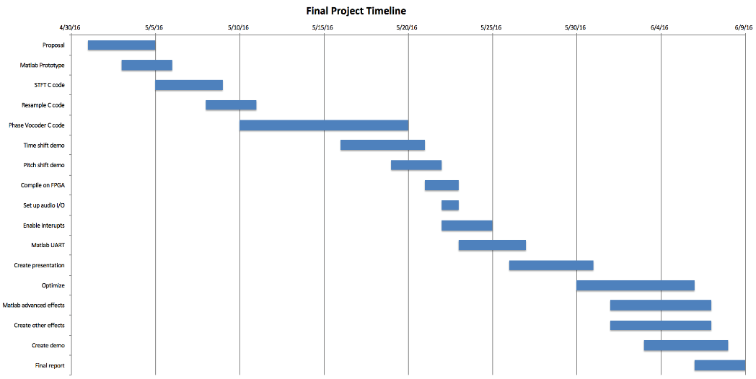
Original Timeline….LOL if only

Slide 14
Timeline
Research, decide to go with phase vocoder
Matlab phase vocoder demo
Write proposal
Phase vocoder C implementation (first wav file, then realtime on Atom)
Phase VocoderFPGA attempt….lots of fail…algorithm takes too long to process
SOLA research…seems like it will be faster (last weekend)
SOLA C implementation (wav file)…resampling non integer is too complicated
Delay method research…faster and less complex
Delay Matlab Demo
Delay C implementation (yesterday)
Ping Pong buffer Research
Delay FPGA attempt (work in progress)
Make slides and present

Slide 15
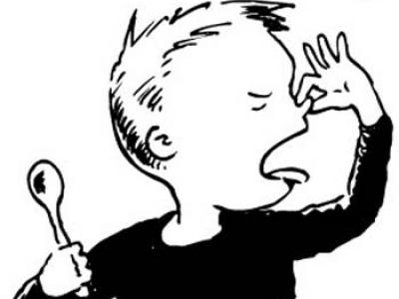
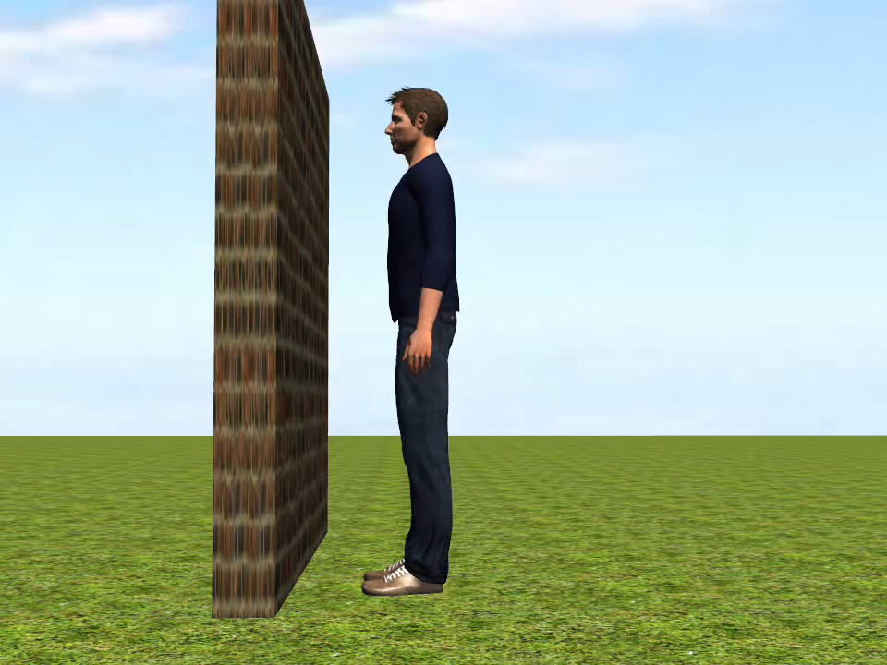
Struggles
Algorithms are complicated
Lots of math
Complex and hard to debug
Not really covered in class or labs
Not many C implementation examples on the internet
No way to know if it works until you write the whole algorithm
We don’t have much info on the hardware limitations
Try…Hope…Fail…Try…Hope…Fail…Try…Hope…Fail… →
Real-time processing
Samples fill buffer before processing completes
Solutions
use faster algorithm… ugh
find better hardware… no thanks
write lower level code… no thanks
Scheduling (Ping Pong buffer)

Slide 16
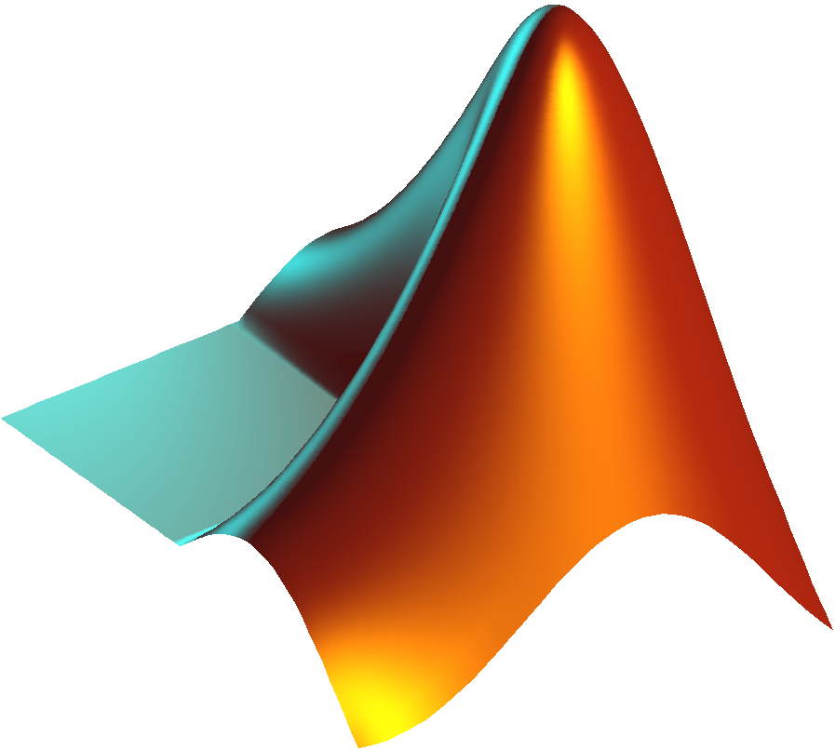
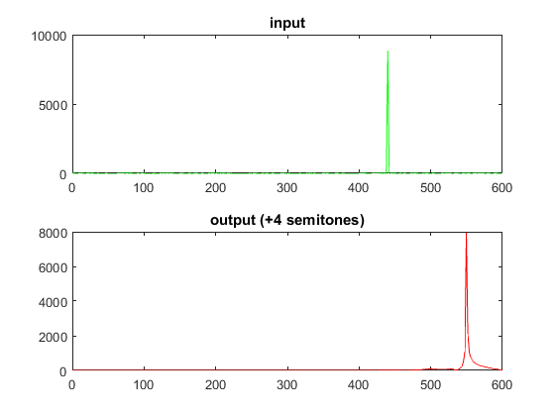
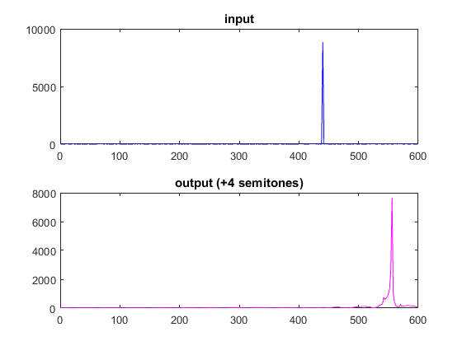
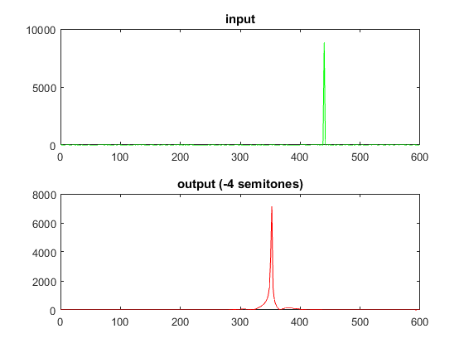
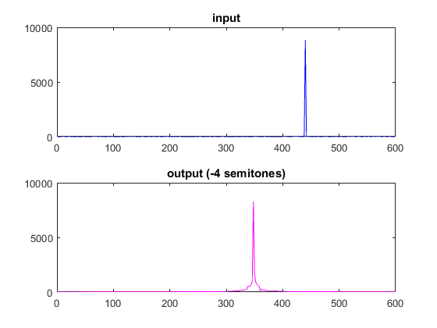
Matlab Demo (440 hz sine Input)
Phase Vocoder
Delay Method

Slide 17
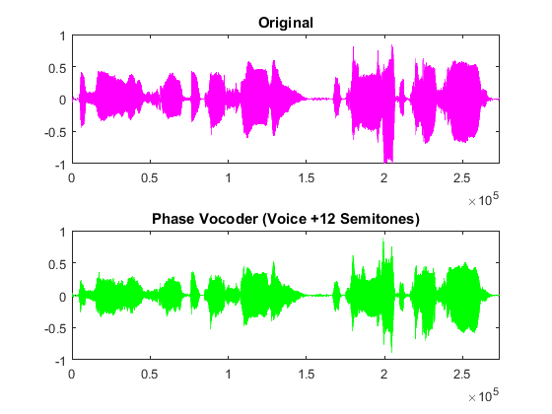
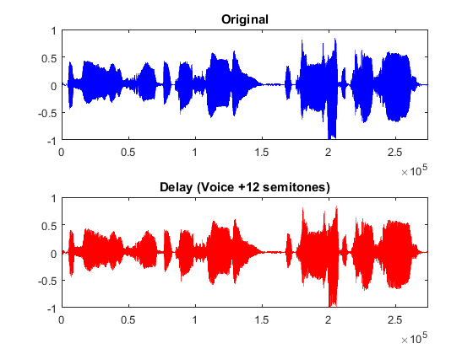
Matlab Demo (Singing)
Phase Vocoder
Delay Method
Original
Original
+12
+12
-12
-12
* Note the shifted output is the same length

Slide 18
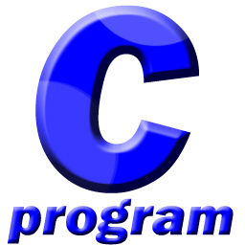
C Demos
 | Original | Phase Vocoder |  | Delay Based *
Sample | 0 semitones Factor: 0 | +4 semitones Factor: 1.26 | -4 semitones Factor: 0.79 | +4 semitones Factor: 1.26 | -4 semitones Factor: 0.79
Sine Wave 440 Hz
Singing Voice
*Delay based semitone calculation is not correct

Slide 19
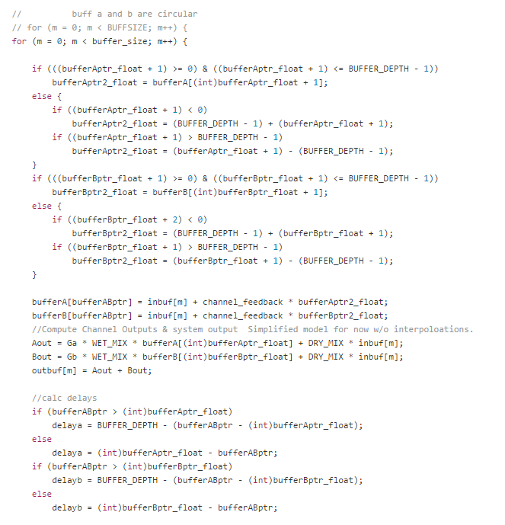
Code Comparison
Phase Vocoder
Matlab : ~180 lines
C : ~450 lines
Delay Method
Matlab : ~150 lines
C : ~ 300
Delay C Code Snippet

Slide 20
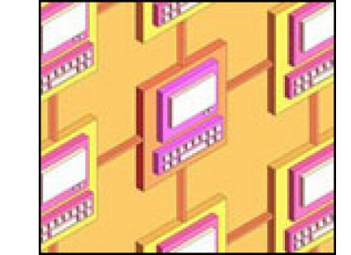
Real-time FPGA Processing
Fill input buffer
Process pitch shift for buffer
Play output while reading in new input
Heavy processing occurs in main, I/O sampling occurs in hardware interrupt
Note: this hinges on the fact that processing is faster than filling the buffer. This is not guaranteed… Ping Pong buffering helps

Slide 21
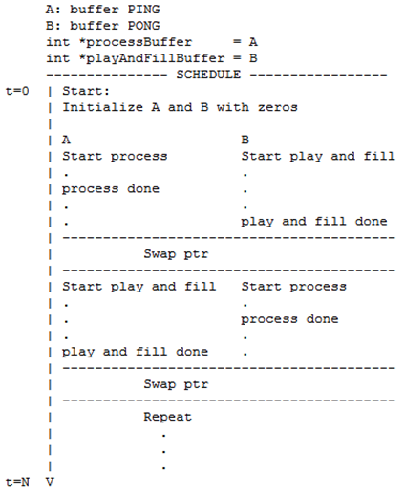
Ping Pong Buffering

Slide 22
PING PONG BUFFERING – play_and_fill

Slide 23
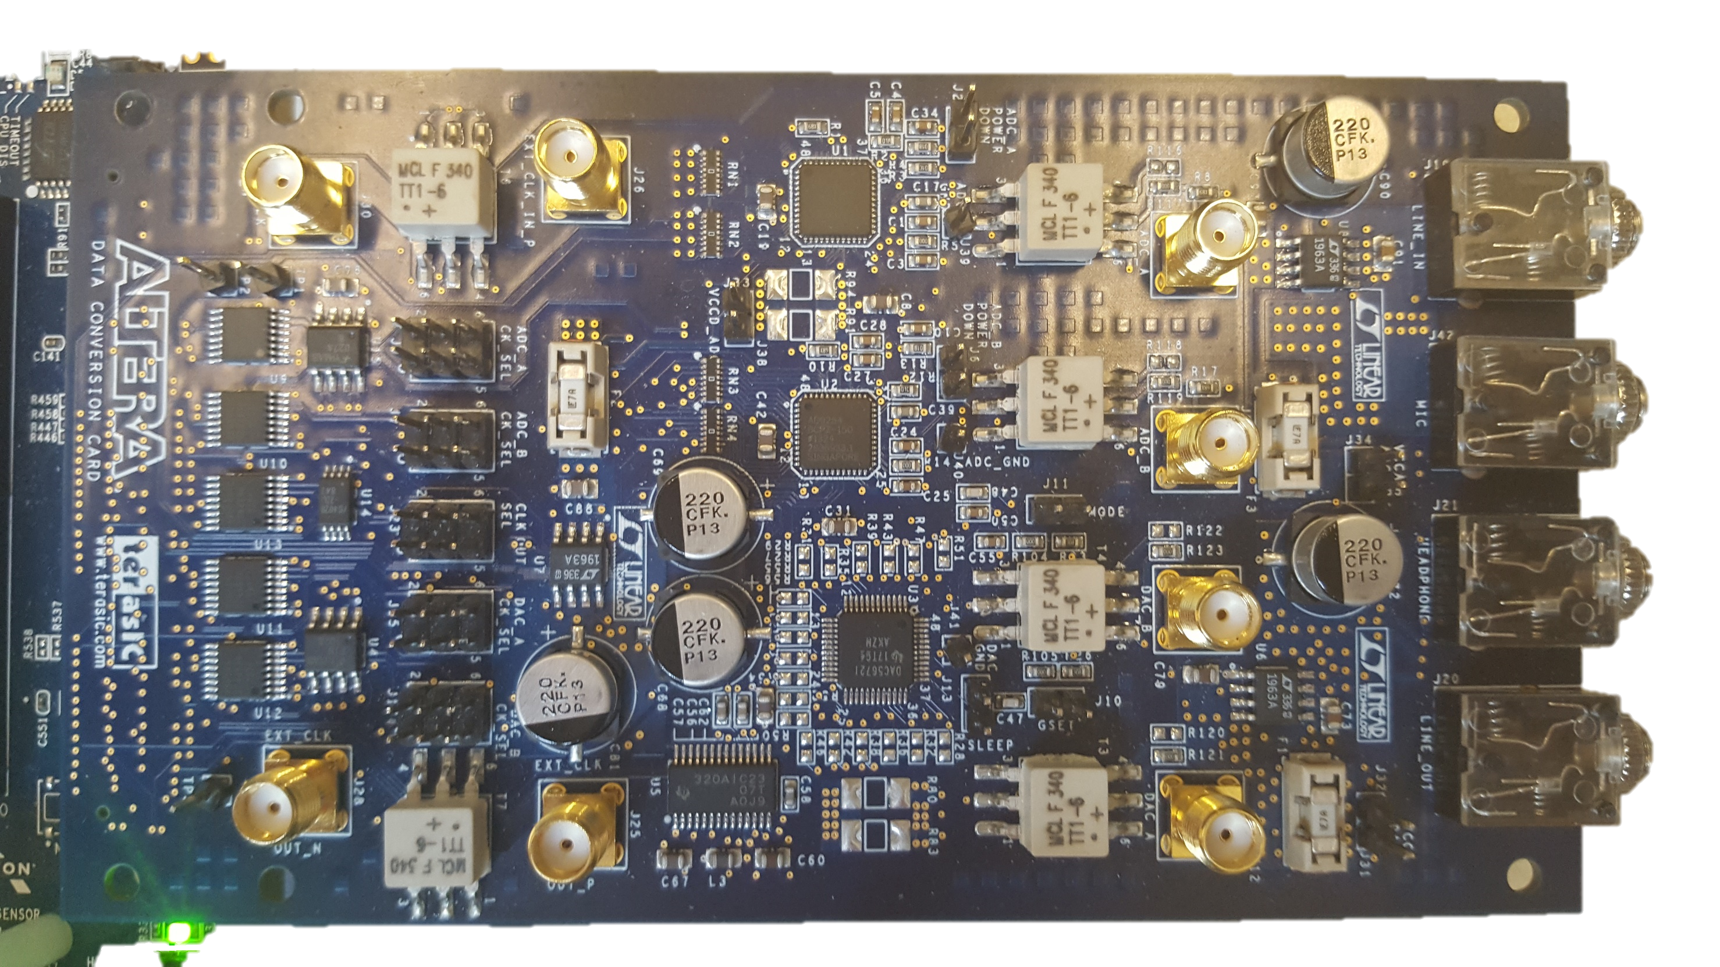
Questions ?

